Slide 1
RABBIT MQ
open-source message broker
implements AMQP – Advanced Message Queuing Protocol
enables Software Applications to connect and scale
Asynchronous decoupling of apps by separating sending and receiving data
Gives
Apps- common platform for sending and receiving msgs.
Messages- safe place to live until received.

Slide 2
Features
Reliability –
persistence, delivery ack, publisher confirms,& high availability
Flexible Routing –
Routed through exchanges before arriving at queues
Clustering –
Several Rabbit MQ servers can be clustered to form one single logic broker
Federation –
For servers that need to be more loosely connected
Highly Available Queue –
Queues can be mirrored across several machines ensuring message safety even in hardware failure
Multi Protocol –
Supports a variety of messaging protocols

Slide 3




Producer
- Sends messages
Queue
Lives inside Rabbit MQ.
Messages stored inside queue
Infinite buffer
Consumer
- Receives messages

Slide 4
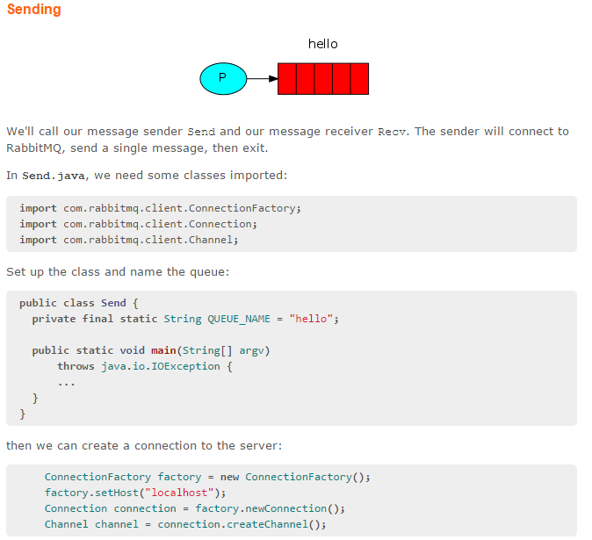
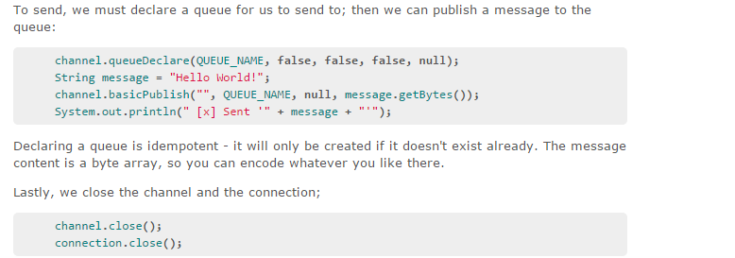

Slide 5
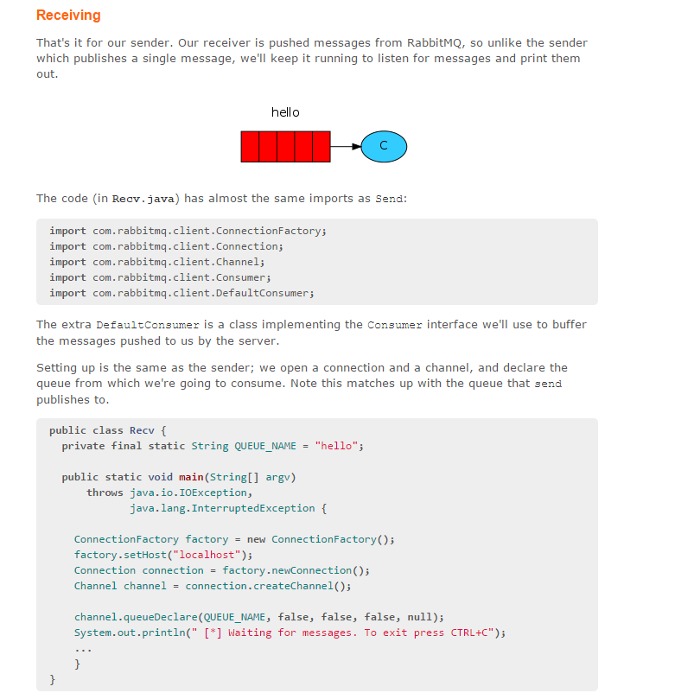
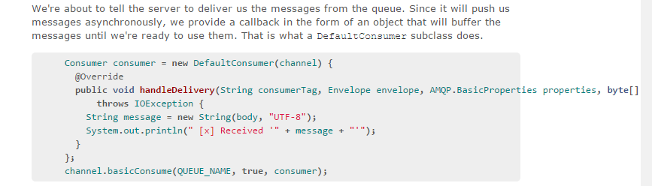

Slide 6
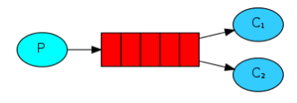
Work Queue
Distributing tasks among workers
Encapsulate task and send to queue.
Worker process pops the task and executes the job.
Tasks shared between many workers
Round-Robin Dispatching
- Rabbit MQ sends each message to the next consumer in sequence.
- On avg every consumer gets the same number of messages.

Slide 7
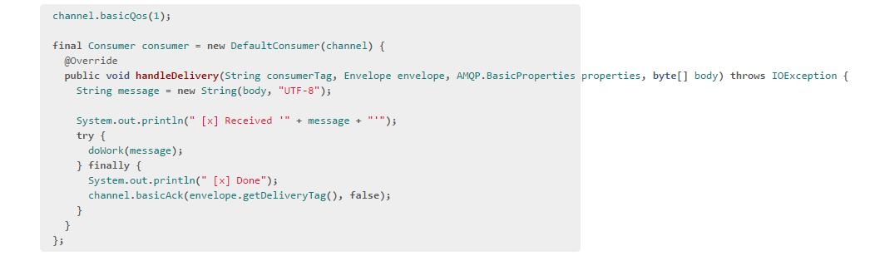
MESSAGE ACK
An ack is sent back from the consumer to tell that a particular msg is received and processed
Msgs are not lost even if consumer dies.
Without Ack, Rabbit MQ reques it.
No msg timeouts. Only when consumer dies msgs are redelivered

Slide 8
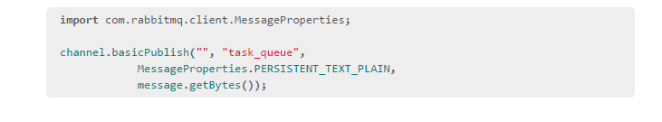
MESSAGE DURABILITY
When Rabbit MQ quits or crashes, it will forger the queues & msgs.
SO mark them both durable.
Queue – declared as durable
Message – marked as Persistent

Slide 9
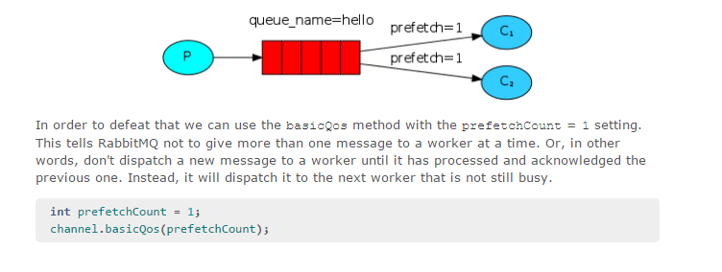
FAIR DISPATCH
Rabbit MQ dispatches msgs evenly without looking at ack.
With prefetchCount = 1, it doesn’t dispatch new msg to a worker until it has processed and ack the previous msg

Slide 10



EXCHANGES
Producer sends msg to exchange
Exchange receives msg from P and send to queue
Types – direct, topic, headers, fanout

Slide 11
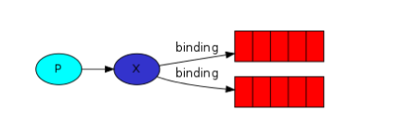

BINDINGS
Relationship between exchange and queue
Binding takes an extra parm called Binding Key

Slide 12
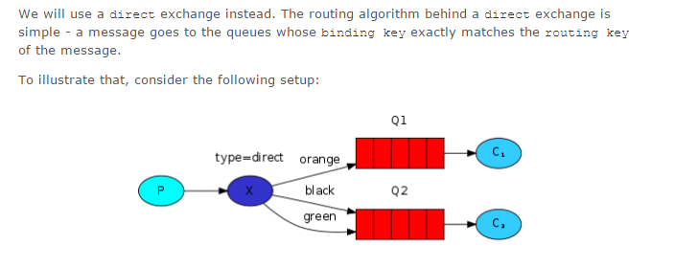
DIRECT EXCHANGE
- filtering of messages
- A msg goes to the queue whose binding key exactly matches the routing key of the msg.

Slide 13
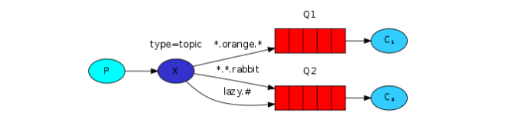
TOPIC EXCHANGE
Msgs sent to topic exchange must be a list of words delimited by dots
Limit – 255 bytes
Binding key must also be in the same form.
A msg with a particular routing key will be delivered to all the queues that are bound with a matching binding key.
2 special cases-
* (star) substitute for exactly one word
# (hash) substitutes for zero or more that one word.

Slide 14
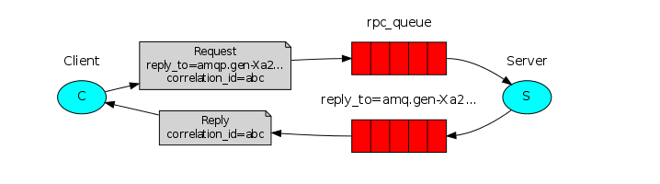
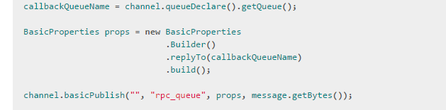
CALLBACK QUEUE
To receive response, we need to send a ‘callback queue’ with the request
Co-relational Id –
Single callback per client instead of every request
Unique value for every request.
Used to match response with request

